Slide 1
BudgetWise AI - Expense Forecaster
MILESTONE 4:🔧 Advanced Admin Panel + System Analytics

Slide 2

🎯 MILESTONE 4 OBJECTIVES
✅ Admin Dashboard Implementation
✅ User Management View
✅ Transaction Monitoring
✅ Basic System Analytics
✅ Security & Access Control

Slide 3
🖥 ADMIN FRONTEND COMPONENTS
Streamlit Interface:
✅ Login system
✅ Tab navigation
✅ Data tables
✅ Basic metrics
Tabs:
• Analytics Dashboard
• User Management
• Transaction View
• Category Management
• System Tools

Slide 4
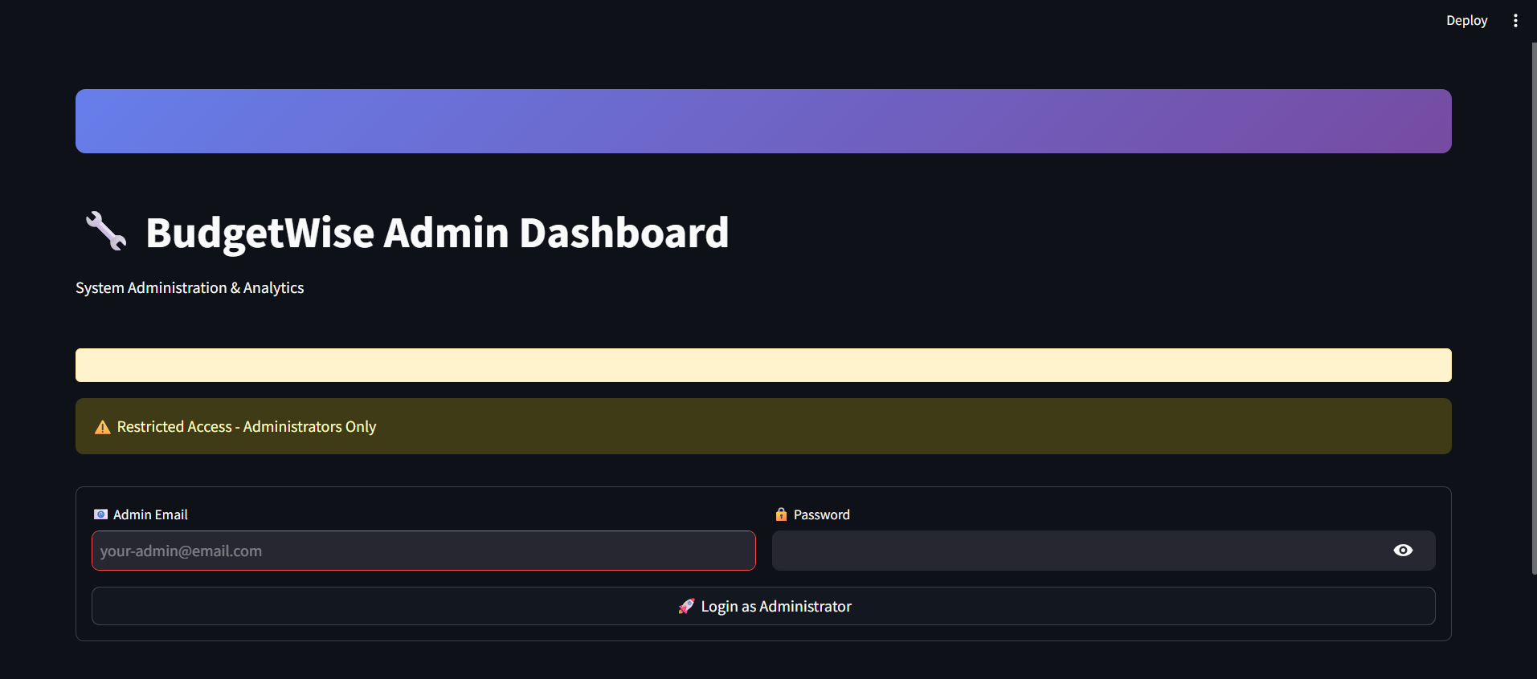
Login page

Slide 5
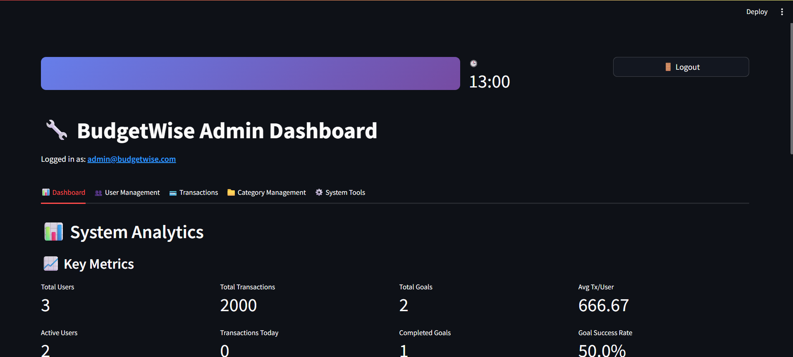
Analytics Dashboard

Slide 6
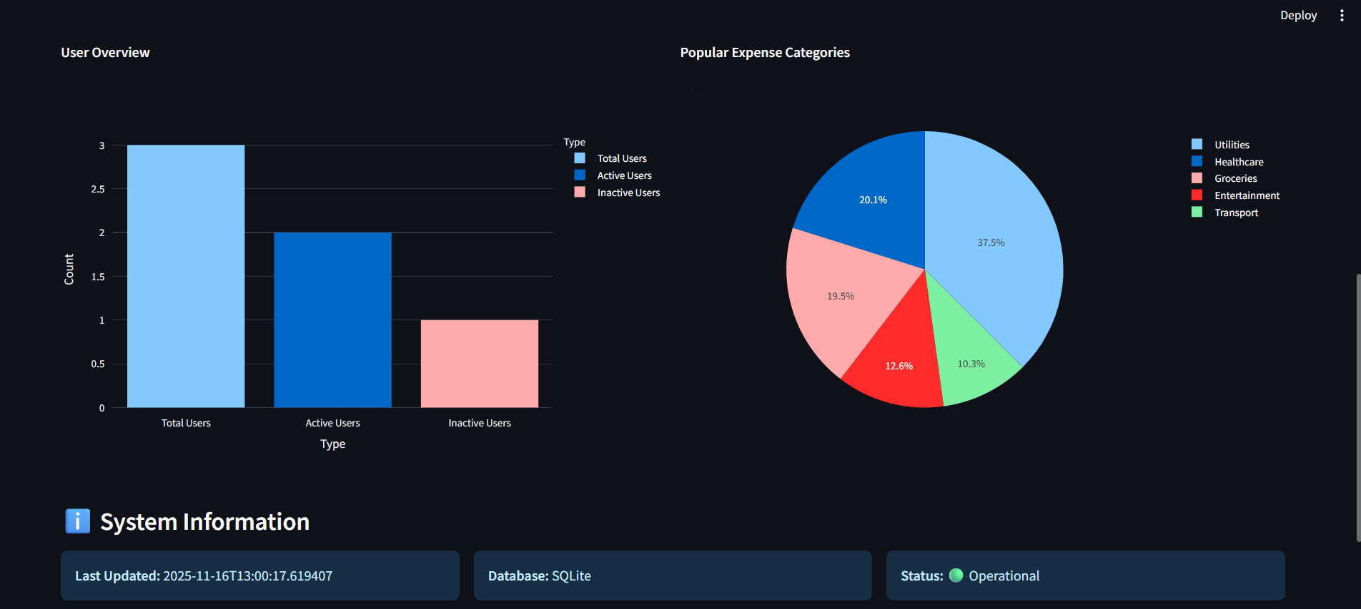

Slide 7
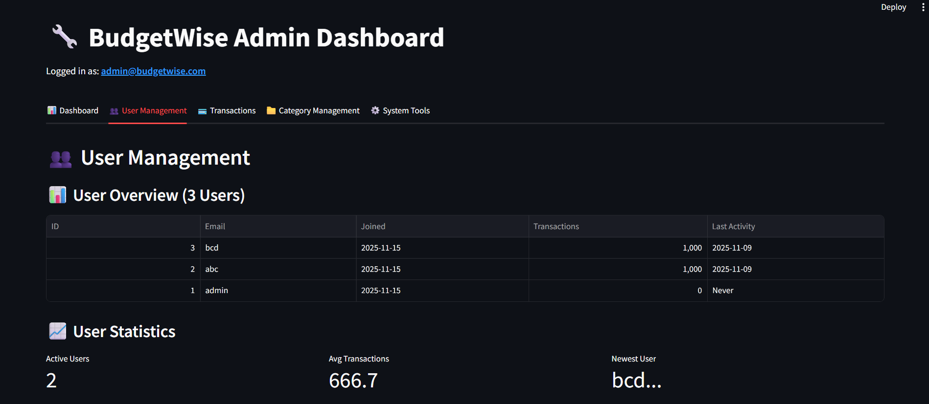
User Management

Slide 8
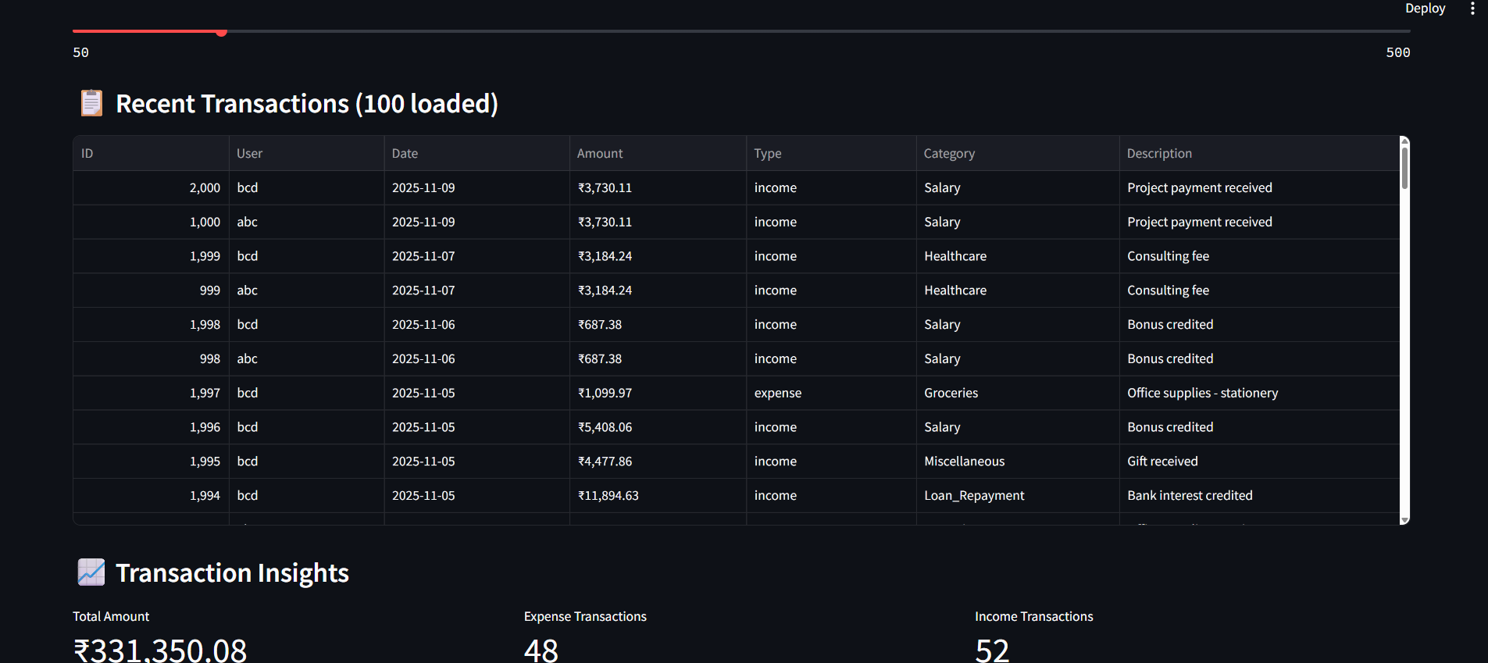
Transaction View

Slide 9
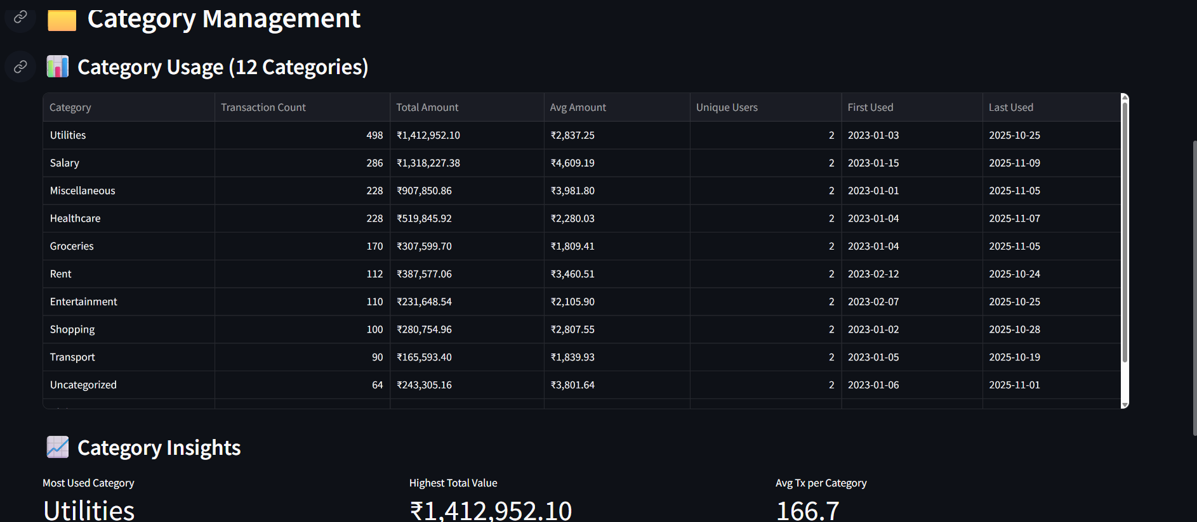
Category Management

Slide 10
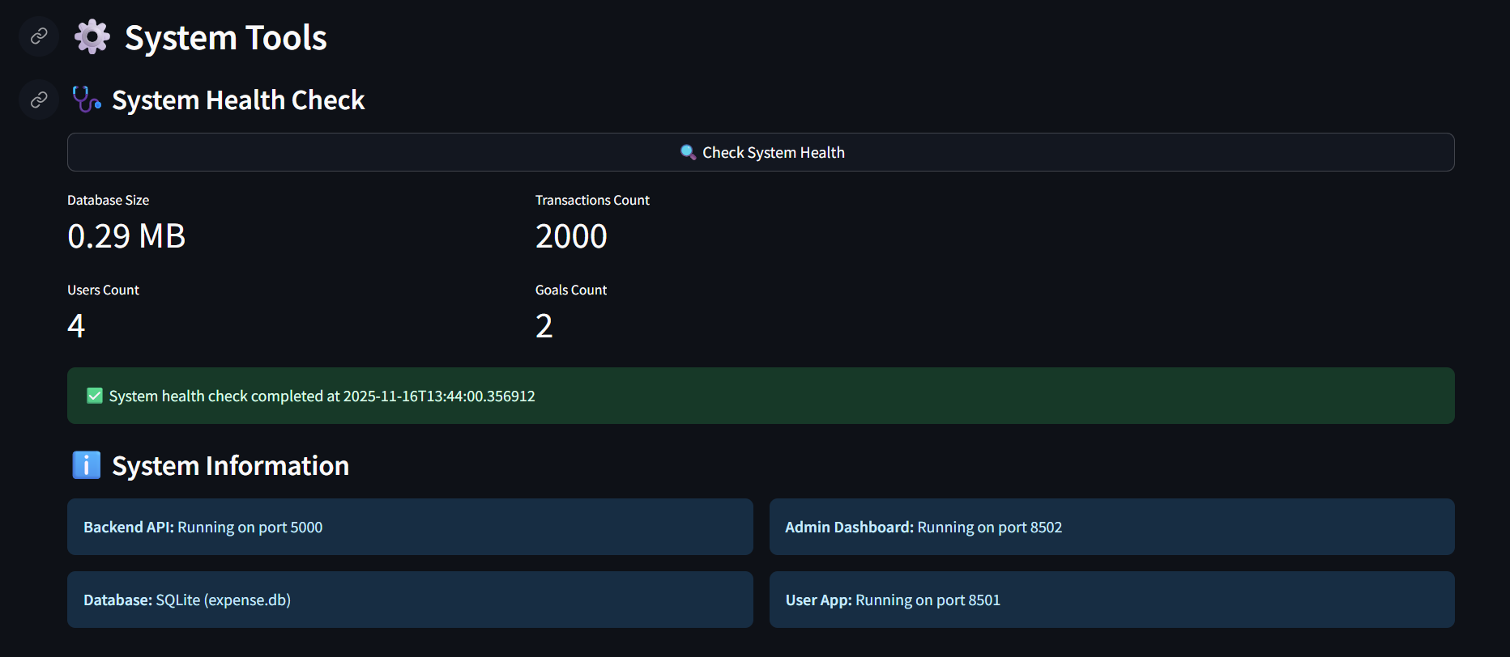
System Overview

Slide 11

🔧 ADMIN DASHBOARD ARCHITECTURE
✅ Separate Streamlit admin interface
✅ Role-based access control
✅ Basic analytics display
Backend: Enhanced app.py
✅ Admin API endpoints
✅ Data security featuresns

Slide 12
🛡 SECURITY IMPLEMENTATION
Admin Authentication:
✅ Hardcoded admin@budgetwise.com
✅ JWT token validation
✅ Protected admin endpoints
Security Features:
• Admin-only API access
• User data separation
• Secure token validation

Slide 13
📊 ADMIN API ENDPOINTS
Backend Endpoints:
✅ GET /admin/check-access - Verify admin status
✅ GET /admin/users - List all users
✅ GET /admin/transactions - View all transactions
✅ GET /admin/analytics - System analytics
✅ GET /admin/categories - Category statistics
✅ GET /admin/system/health - System health check
All endpoints use @jwt_required()

Slide 14

👥 USER MANAGEMENT FEATURES
Features:
✅ View all registered users
✅ User registration dates
✅ Transaction counts
✅ Last activity tracking
Data Display:
• User emails
• Join dates
• Activity status
• Basic statistics

Slide 15

💳 TRANSACTION MONITORING
Features:
✅ View all user transactions
✅ Transaction details
✅ User association
✅ Basic filtering
Display:
• Transaction amounts
• Categories
• Dates
• User emails

Slide 16
🎯 MILESTONE 4 COMPLETION
Delivered Features:
🔧 Admin Dashboard
📊 Basic Analytics
👥 User Management
💳 Transaction View
🛡 Security System
Technical Implementation:
• 6 admin API endpoints
• Secure access control
• Data isolation
• Basic monitoring

Slide 17
🎯 MILESTONE 4 COMPLETION
Delivered Features:
🔧 Admin Dashboard
📊 Basic Analytics
👥 User Management
💳 Transaction View
🛡 Security System
Technical Implementation:
• 6 admin API endpoints
• Secure access control
• Data isolation
• Basic monitoring

